Slide 1


Lecture Topic 15: Value and Valuation – A More In-Depth Review
Presentation to Cox Business Students
FINA 3320: Financial Management
Presentation to Cox MBA Students
FINA 6214: International Financial Markets

Slide 2
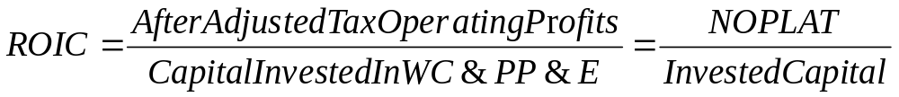
Rick’s Hardware: A Simple Example
Stage 1: The Early Years
  Rick owns a small chain of hardware stores
  To keep it simple, FINA 3320 Consultants tell Rick to focus on Return On Invested Capital (ROIC)
  Rick’s ROIC is 18%, and we suggest WACC is 10%
  Rick has a store that is earning 14% ROIC
    If Rick closes the store with the 14% ROIC, he believes he will increase the firm’s average ROIC
Should Rick close the store with a 14% ROIC?

Slide 3
Rick’s Hardware: A Simple Example
Should Rick close the store with the 14% ROIC?
  NO!
  FINA 3320 Consultants now tell Rick that he should care not about ROIC itself, but the combination of two items:
    (1) ROIC relative to WACC (the firm’s cost of capital)
    (2) Amount of capital invested
  This information can be expressed as Economic Profit:
    FINA 3320 Consultants show Rick that as long as there is a positive spread of ROIC over WACC, additional Invested Capital will produce a higher Economic Profit!
    Rick’s objective should be to maximize long-term Economic Profit

Slide 4
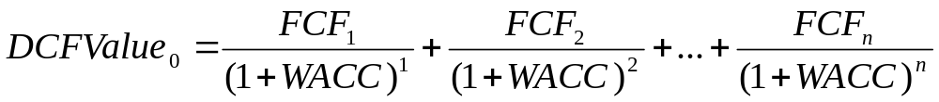
Rick’s Hardware: A Simple Example
Stage 2: Growing the Business
  For many years, Rick was happy with the Economic Profit framework (until he developed Rick’s Superhardware idea)
    If Rick undertakes Superhardware concept, the firm’s Economic Profit will drop for the first four years, after which it will be higher
    How was Rick to determine the trade-off between short- and long-term Economic Profit?
  FINA 3320 Consultants now tell Rick that he needs some more sophisticated financial tools, DCF:
    DCF Value of firm without the Superhardware concept is $53M
    DCF Value of firm with the Superhardware concept is $62M

Slide 5

Rick’s Hardware: A Simple Example
Should Rick undertake the new concept?
  Of course!
    Rick’s new Superhardware concept is projected to be more valuable than the present concept
  But now Rick is confused and asks:
    “When do I use Economic Value and when do I use DCF?”
  FINA 3320 Consultants tell Rick that Economic Profit and DCF are the same:

Slide 6
Rick’s Hardware: A Simple Example
Stage 3: Rick Goes Public
  Using DCF framework, Rick makes many important long-term strategic decisions and Superhardware is successful
  Rick now wants to expand but needs access to more capital
    Rick decides he should undertake an IPO and returns for advice…
  FINA 3320 Consultants tell Rick that he will have to learn to manage both the financial markets and the real markets
  Real Markets
    Until now, Rick has had to manage the real markets by addressing:
      Amount of cash flow earned relative to the amount of capital invested
      Maximization of value via Economic Profit and DCF
    Decision Rule for Real Market decisions
      Choose strategies or make operational decisions that maximize PV of future FCFs

Slide 7
Rick’s Hardware: A Simple Example
  Financial Markets
    FINA 3320 Consultants explain to Rick that when the firm enters the financial, or capital, markets, the real market decision rule does not change
    However, life becomes more complicated because management must now simultaneously deal with outside investors and analysts
  FINA 3320 Consultants tell Rick that he will have to continue maximizing value, but that he must learn to also manage investors’, or the market’s, expectations
    If the market’s expectations are higher than what is ultimately realized, the stock’s price will fall even though ROIC > WACC
      The loss of credibility in this instance may take years to overcome
    If the market’s expectations are too low, share price will be too low, and the firm may be subject to a hostile takeover

Slide 8
Rick’s Hardware: A Simple Example
Stage 4: Conglomerate Expansion
  Publicly-traded Rick’s Hardware grew quickly and regularly beat expectations and became a top market performer
    So, Rick decided to expand into Rick’s Furniture and Rick’s Garden Supplies
    But Rick was concerned about delegating decision-making to management (as he knew he must if he expanded)
  FINA 3320 Consultants explain to Rick that he needed a planning and control system to tell him about the “health” of the firm
    That is, the ability of the firm to continue to grow and create value
    This required a forward-looking metric, not just backward-looking ones

Slide 9
Rick’s Hardware: A Simple Example
  FINA 3320 Consultants explain to Rick that the problem with financial metrics is that they cannot tell how management is doing in terms of creating future value
  For example:
    In the short run, managers could improve short-term financial results by cutting back on customer service
      i.e., decreasing the number of employees available in the store at any time to help customers, or reducing employee training
    Or, in the short run, management could improve short-term financial results by deferring maintenance on existing fixed assets, deferring purchase of new fixed assets, or reducing spending on brand-building (e.g., advertising, etc.)
  Rick’s hardware must incorporate metrics related to customer satisfaction or brand awareness
    Such metrics provide an idea about the future, not just the present

Slide 10
Rick’s Hardware: A Simple Example
Summarizing Rick’s Hardware Lessons
    (1) In the real market, you create value by earning a ROIC greater than the opportunity cost of capital, or WACC
    (2) The more you can invest above the cost of capital, the more value you create
      Growth creates more value as long as the ROIC exceeds the WACC
    (3) You should select strategies that maximize the PV of expected cash flows, or Economic Profit
      You get the same answer regardless of which you choose
    (4) The value of a firm’s shares in the stock market is based on the market’s expectations of future performance
      Market’s expectations can deviate from intrinsic value if the market is less than fully informed about the firm’s true prospects
    (5) After the initial price is set, shareholders’ returns earned depend more on the changes in expectations about the firm’s future performance than the actual realized performance of the firm

Slide 11
Long-Term Financial Forecasting
The Pro Forma Financial Statement

Slide 12
Past and Future
Historical data provides an analyst with an understanding of the past and present of a firm’s cash flows
  However, it doesn’t provide much in the way of the present value of the firm
Historic cash flows have already been obtained
  Therefore, new owner would not be entitled to these historic cash flows
We require forward-looking (pro forma) statements to estimate future cash flows

Slide 13
Assessing Firm’s Future ‘Health’
Assessing the long-term financial health of a firm is an important task for:
  (1) Managers: as they formulate goals and strategies
  (2) Creditors: as they consider lending money
  (3) Investors: as they consider buying equity
Management has to be able to predict future growth in sales, assets, etc.
Management must also ensure funds are available for growth

Slide 14
Pro Forma Financial Statements
Forward looking statements allow managers and external analysts to:
  (1) Assess whether anticipated performance is in line with firm’s targets and investors expectations
    If not, managers can try to remedy the situation
  (2) Forecast amount of external financing required
  (3) Evaluate the impact that changes in the operating plan have on the value of the firm
    “What-if” analysis
  (4) Estimate future free cash flows, which determine firm’s overall value

Slide 15
Ingredients of Pro Forma
Sales forecast may be derived using one of two approaches
  Top-down:
    Relies heavily on macroeconomic and industry forecasts
    However, senior management usually establishes firm’s objectives for increased sales
      Start with reviews of sales and sales growth over past 5-10 years
  Bottom-up:
    Begins by talking to customers to assess demand
Many firms use a blend of the two approaches

Slide 16
Ingredients of Pro Forma
Perfectly accurate forecasts are not available because sales depends on uncertain future state of:
  (1) Economy
  (2) Industry
  (3) Company
Scenario analysis should be used to examine what happens under various assumptions and states:
  (1) Most Likely Worst-case
  (2) Most Likely, or Base-case
  (3) Most Likely Best-case

Slide 17
Ingredients of Pro Forma
Pro Forma Financial Statements
  Analyze historical ratios, forecast balance sheet, income statement, and sources and uses of cash
Asset requirements
  What are the firm’s planned capital expenditures?
  What are firm’s net working capital needs?
Financial requirements
  How will the firm finance its growth?
    Internal retained earnings (RE): Net income – Dividends
    External: New Debt and/or New Equity
  Capital structure and dividend policies

Slide 18

Ingredients of Pro Forma
Economic assumptions
  Interest rates, industry growth rates, etc.
Plug
  Pro forma will usually assume that sales, costs, and net income grow at g₁
  If pro forma assumes that assets and liabilities grow at g₂, a third variable (e.g., equity) may be forced to grow at g₃ in order to make the first two growth rates compatible and have the balance sheet identity hold:

Slide 19
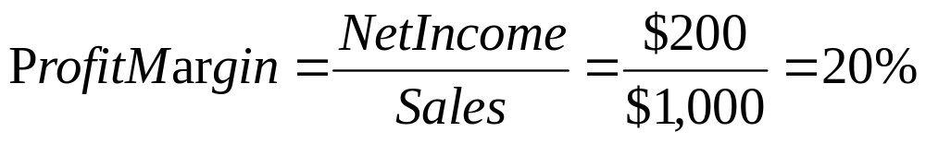
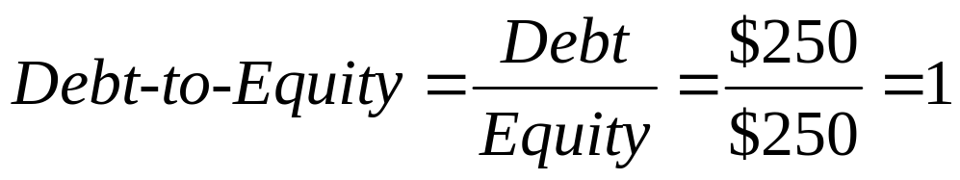
Example: Pro Forma – The Plug
Income Statement 2008 | Balance Sheet 2008
Sales $1,000 | Assets $500 | Debt $250
Costs 800 |  | Equity 250
Net Income $ 200 | Total $500 | Total $500
  Assume all variables are directly tied to sales (i.e., grow at same rate) and current relations are optimal
  What happens to balance sheet and income statement if sales are forecast to increase by 20% in 2009?

Slide 20
Example: Pro Forma – The Plug
Income Statement 2009 | Balance Sheet 2009
Sales $1,200 | Assets $600 | Debt $300
Costs 960 |  | Equity 300
Net Income $ 240 | Total $600 | Total $600
  Net income is $240 in 2009
  But equity only increased by $50 since we assumed it grew at the same rate as sales
  What does this imply about dividends?
  The firm must have paid $190 in dividends

Slide 21
Example: Pro Forma – The Plug
  If firm pays no dividends, but assets still grow by 20%, what does the balance sheet look like?
  Since equity increased by $240, firm must have bought back $140 of debt in order for assets to grow by 20%
Income Statement 2009 | Balance Sheet 2009
Sales $1,200 | Assets $600 | Debt $110
Costs 960 |  | Equity 490
Net Income $ 240 | Total $600 | Total $600

Slide 22
Percent of Sales Method
Most common technique to forecast balance sheet and income statement
  Begins with sales forecast expressed as an annual growth rate in sales revenues
  Assumes that many items on balance sheet and income statement increase proportionally with sales
    Forecasted value is % of forecasted sales
    Cash/Sales next year = Cash/Sales this year
      Or average of Cash/Sales for past x years
  Remaining items that are not directly tied to sales depend on firm’s dividend policy and its use of debt versus equity financing

Slide 23
Percent of Sales Method
  (1) Forecast sales
  (2) Analyze historical ratios
    Percent of sales approach assumes costs/assets are a specified percentage of that year’s sales
    Calculate ratio of costs and/or assets to sales in past years and assume ratio remains constant in the future
  (3) Forecast income statement
    Note: Interest expense is function of amount of debt and interest rate, and is not assumed to be fixed percent of sales
    Tax rate and depreciation also not generally assumed to be fixed percent of sales

Slide 24
Percent of Sales Method
  (4) Forecast balance sheet
    Note: Firms rarely issue common stock or preferred stock, so their forecasts are usually equal to last year’s amount
    Further, we usually assume that firms will not issue any new long-term debt, which often requires approval of board of directors
    Change in RE is function of net income and dividends paid
  (5) Given above forecasts, are additional funds needed?
    Compare forecasted assets to forecasted liabilities + equity

Slide 25
Percent of Sales Method
    Current sales = $20,000,000, and are expected to grow at 10% over the next year
    Assets and current liabilities vary directly with sales (stay same % of sales)
    Profit margin = 10%
    Dividend payout = 50%
    Given this information, forecast the firm’s pro forma balance sheet
Balance Sheet 2008
Current Assets | $ 6,000,000
Fixed Assets | 24,000,000
Total Assets | $30,000,000
Current Liabilities | $10,000,000
Long-Term Debt | 6,000,000
Common Stock | 4,000,000
Retained Earnings | 10,000,000
Total Liabs & Equity | $30,000,000

Slide 26
Percent of Sales Method
Balance Sheet 2008 |  | % of Sales | Balance Sheet 2009
Current Assets | $ 6,000,000 | 6/20 = 30% | $ 6,600,000 ($22,000,000 x 0.3)
Fixed Assets | 24,000,000 | 24/20 = 120% | 26,400,000 ($22,000,000 x 1.2)
Total Assets | $30,000,000 | 30/20 = 150% | $33,000,000 ($22,000,000 x 1.5)
Current Liabilities | $10,000,000 | 10/20 = 50% | $11,000,000 ($22,000,000 x 0.5)
Long-Term Debt | 6,000,000 | Constant | 6,000,000
Common Stock | 4,000,000 | Constant | 4,000,000
Retained Earnings | 10,000,000 |  | 11,100,000*
Total Liabs & Equity | $30,000,000 |  | $32,100,000
    The firm has $33M in assets, but only $32.1M in liabilities and equity, so it needs to issue $900,000 in external funds

Slide 27
How to Forecast Interest Expense
Interest expense is actually based on the daily balance of debt during the year
There are three ways to approximate interest expense
  Base it on:
    (1) Debt at end of year
    (2) Debt at beginning of year
    (3) Average of beginning and ending debt

Slide 28
Forecasting Interest Expense
(1) Base interest expense on debt at end of year
    Will over-estimate interest expense if debt is added throughout the year instead of all on January 1st
    Causes circularity called financing feedback
      more debt causes more interest, which reduces net income, which reduces retained earnings, which causes more debt, etc.
(2) Base interest expense on beginning of year debt
    Will under-estimate interest expense if debt is added throughout the year instead of all on December 31st
    But doesn’t cause problem of circularity
(3) Base interest expense on average debt
    Will accurately estimate interest payments if debt is added smoothly throughout year
    But also has problem of circularity

Slide 29
Forecasting Interest Expense - Solution
If calculating with calculator (by hand), base interest expense on beginning debt, but use a slightly higher interest rate
  Easy to implement
  Reasonably accurate
If using Excel, the spreadsheet can solve the circularity problem, so use average debt
  Office 2003: Open Excel and go to:
    Tools Options Calculation (click on iteration)
  Office 2007: Click on Microsoft Office Button
    Excel options Formulas Calculation options
    (click on Enable iteration)

Slide 30
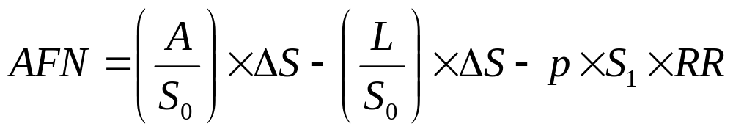
Additional Funds Needed (AFN)
If ratios are expected to remain constant, the following formula can be used to forecast funds needed:
  Where A are the assets tied directly to sales
  L are the liabilities tied directly to sales
  S₀ is this year’s sales
  ∆S is the change in sales
  S₁ is next year’s projected sales
  p is the profit margin
  RR is the retention ratio, or (1 – dividend payout ratio)

Slide 31
Additional Funds Needed (AFN)
Using the information from our previous example:
  Where A = $30 million (i.e., total assets)
  L = $10 million (i.e., current liabilities)
  S₀ = $20 million (i.e., given)
  S₁ = $22 million (i.e., $20 x 1.1)
  ∆S = $2 million (S₁ – S₀)
  p = 0.10 (i.e., given)
  RR = 1 – 0.5 (i.e., dividend payout ratio given)

Slide 32
Problems with AFN and Percent of Sales Methods
In reality, these models are too simple
  Costs are not always proportional to sales
  Assets are not always a fixed proportion of sales, etc.
    Economies of scale may result in the ratios changing over time as firm size increase
    Fixed assets may be “lumpy” and need to be added in large, discrete units
    Excess capacity can allow sales to grow with no increase in fixed assets
Percent of sales is only a starting point
  Use common sense and your knowledge of the firm to think more deeply about what items might deviate from a constant proportion

Slide 33
What Determines Sales Growth?
Firms frequently make sales growth assumptions a part of the planning process
We know, however, that the goal of management should be shareholder wealth maximization
Thus, growth should not be a goal in and of itself, but a consequence of decisions that maximize NPV
Otherwise, if management accepts negative NPV projects just to grow the firm, shareholders (but not necessarily managers) will be worse off!

Slide 34


Sustainable Growth Assumptions
(1) Assets grow in proportion to sales
(2) Net income is constant proportion of sales
  i.e., Profit margin is constant
(3) Dividend payout (d) and debt/equity ratio (DE) are fixed
(4) Number of shares outstanding is fixed
  i.e., No new equity is issued

Slide 35
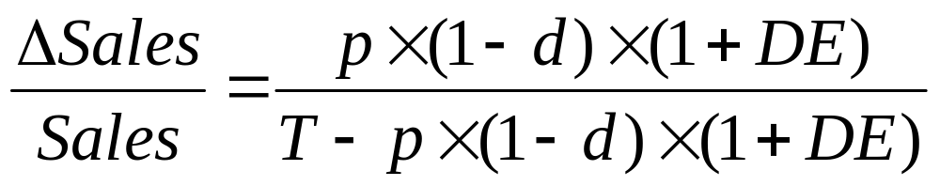
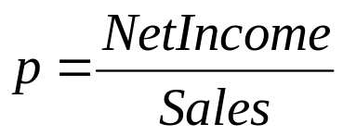
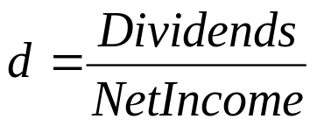
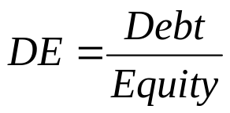
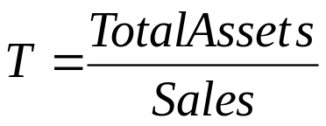
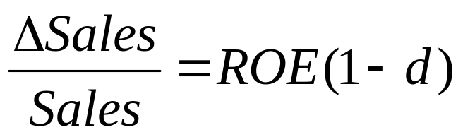
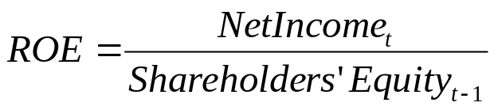
Sustainable Growth Assumptions
Under the previous assumptions, the amount by which a firm can increase sales without increasing leverage (i.e., total debt/total assets) or issuing new equity is fixed and given by:
  Where , , ,
Approximation:
  Where ,

Slide 36
Sustainable Growth Assumptions
Assumptions 1 and 2 hold investment policy and ROI constant
Assumptions 3 and 4 hold dividend and financing policies constant
The formula says that a firm’s sustainable growth depends on profit margin, asset turnover, dividend policy, and capital structure
Firm cannot grow faster than ∆S/S, unless
  (1) Issue new equity
  (2) Change one of the factors in sustainable growth formula
    Decrease dividend payout, Increase profit margin, or ∆ capital structure

Slide 37
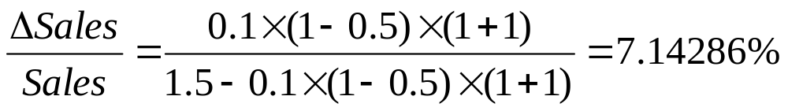
Example: Sustainable Growth
  p = profit margin = 10%
  T = total assets/sales = 150%
  DE = D/E = 100%
  D = dividend payout = 50%
If firm does not want to grow, what would it need to do?
  Change dividend payout to 100%!

Slide 38
Uses of Sustainable Growth
Bankers and credit analysts use sustainable growth formula to assess a firm’s creditworthiness
If actual growth consistently exceeds sustainable growth, borrower runs the risk of “growing broke” unless it can continue to raise external funds

Slide 39
Thank You!
Charles B. (Chip) Ruscher, PhD
Department of Finance and Business Economics

